Slide 1
ENEL 441 – Control Systems I
Unit 1 – Modelling and Representations
Arne Dankers
01-17-2023

Slide 2
Lecture notes on Git and D2L
On D2L – all files, except videos are in a .zip file called Unit1.zip.

Slide 3
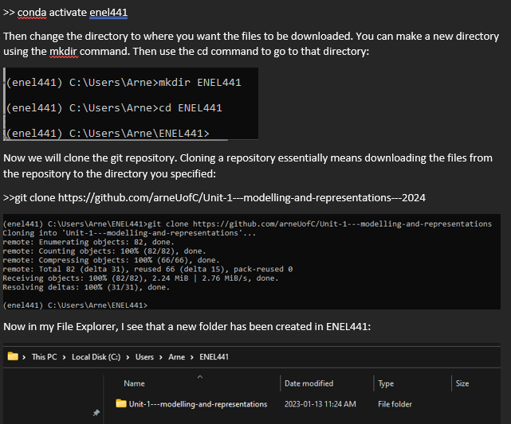
Using Git – Cloning a Repository
Note the year

Slide 4
Using Git – Downloading most current files from Repository
For those of you are running a local version of python to run Jupyter notebooks:
If you already cloned the repository on your machine, take a pull:
Open Anaconda prompt
Activate virtual environment or enel441:
>>conda activate enel441
Change directory to where you originally cloned the repo. In the instructions the directory was ENEL441:
>>cd repo_directory
Update your local files so that they match the files in the remote repository:
>> git pull
Open Jupyter notebooks:
>> jupyter notebook
When Jupyter opens in a web browser, you should see a file list. Open the file ‘Unit 1 – Modelling and Simulation in Time Domain.ipynb.
If you did not clone the repository onto your machine, follow the instructions posted on D2L and do so now.
For those of you running notebooks via Google Colab, no need to do anything, just follow the instructions posted on D2L to connect the repo. Open the file `Unit 1 – Modelling and Simulation in Time Domain.ipynb’

Slide 5
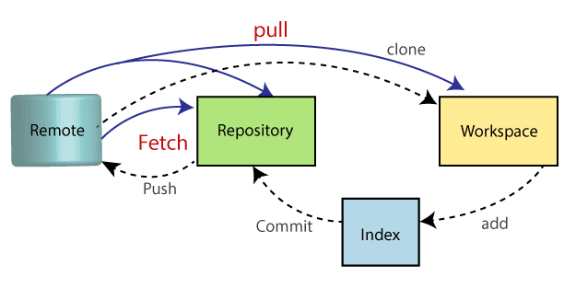
Git – What is it and How does it work?
Used for software version control

